Slide 1
Ixtoc I Oil Well

Slide 2
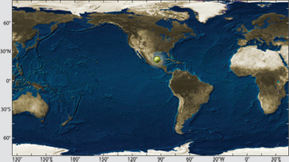

Slide 3
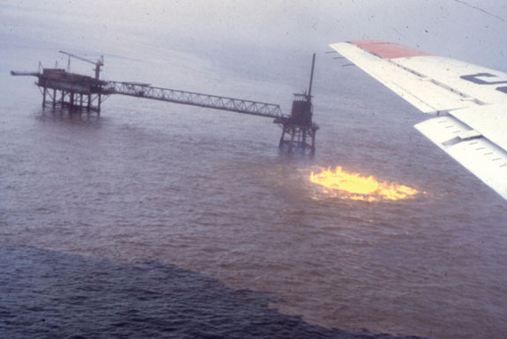

Slide 4
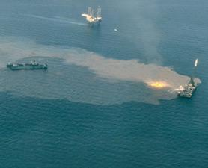

Slide 6
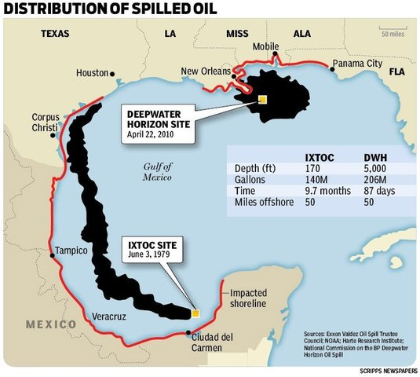

Slide 7
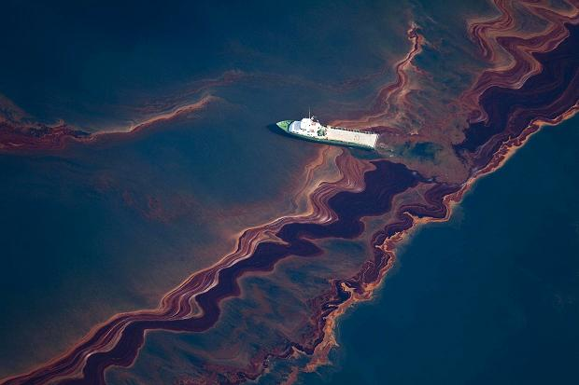

Slide 8
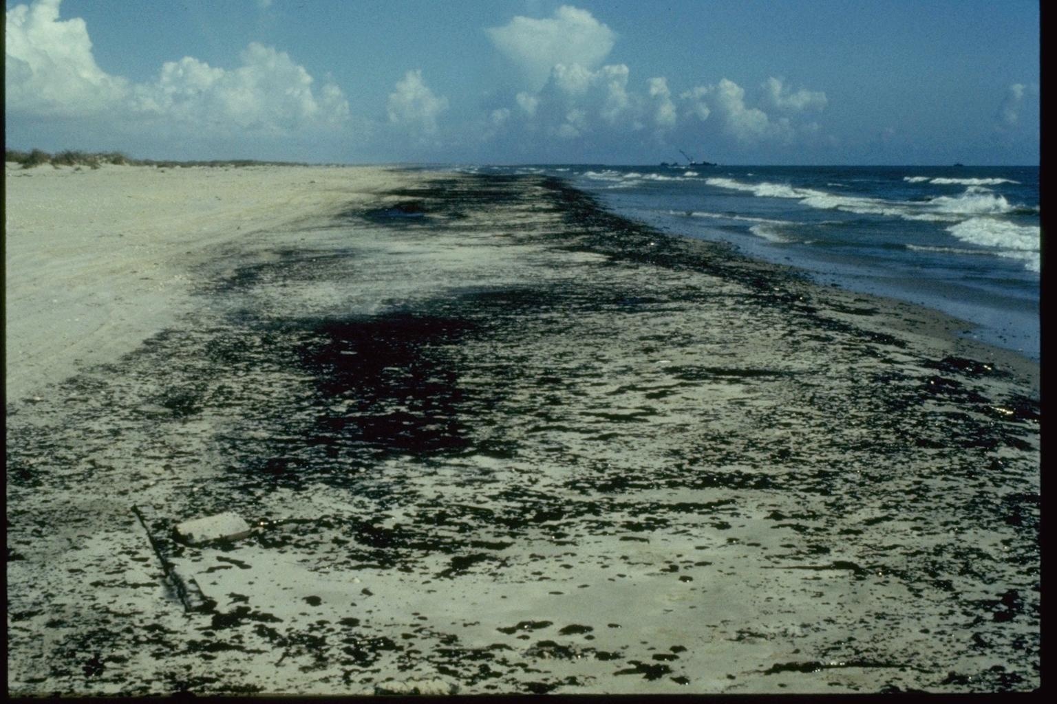

Slide 9
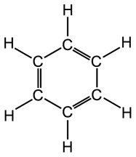
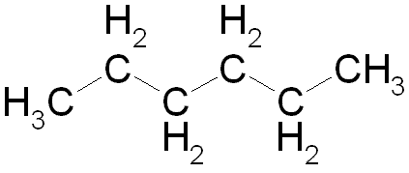

Slide 10
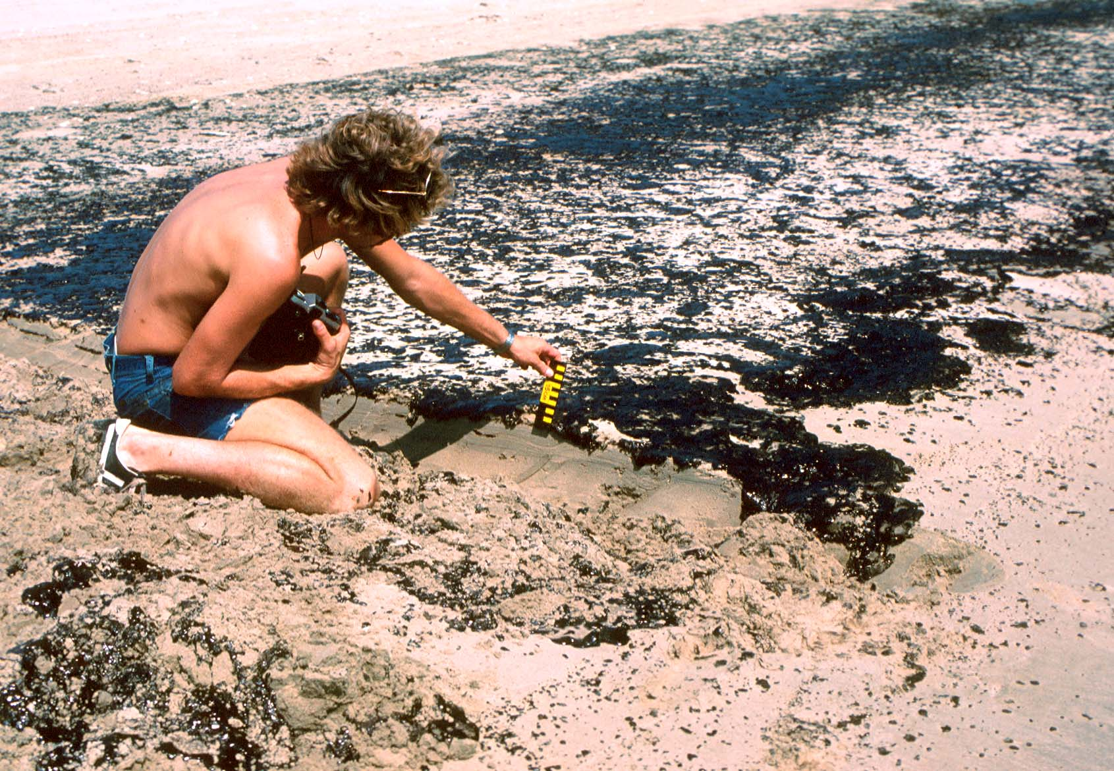

Slide 11
Sites:
http://www.whoi.edu/oil/ixtoc-I
http://www.counterspill.org/disaster/ixtoc-oil-spill
http://news.discovery.com/earth/weather-extreme-events/gulf-oil-spill-ixtoc.htm
http://www.sciencecorps.org/crudeoilhazards-workers.pdf

